Slide 1
Modeling Comprehensive Controlling Strategies
Cristina Lanzas and Shi Chen
CBS 810 Infectious disease modeling

Slide 2
Learning objectives
Revisit the epidemiological triad
List the potential controlling strategies in the epidemiological triad
Explain how modeling can be applied to evaluate potential controlling strategies

Slide 3
Epidemiological Triad Revisited
HOST
VECTOR
PATHOGEN
ENVIRONMENT

Slide 4
Epidemiological Triad Revisited
Factor 1 | Factor 2 | Potential Strategies
Pathogen
Host
Environment
Pathogen | Host
Pathogen | Environment
Host | Environment
Vector

Slide 5
What Can We Do with Modeling?
Recall what we have learned from the beginning:

Slide 6
Parameter: To Be Constant or Not?
Beta: transmission coefficient
Decreasing Beta?
Gamma: recovery rate
Increasing Gamma?

Slide 7
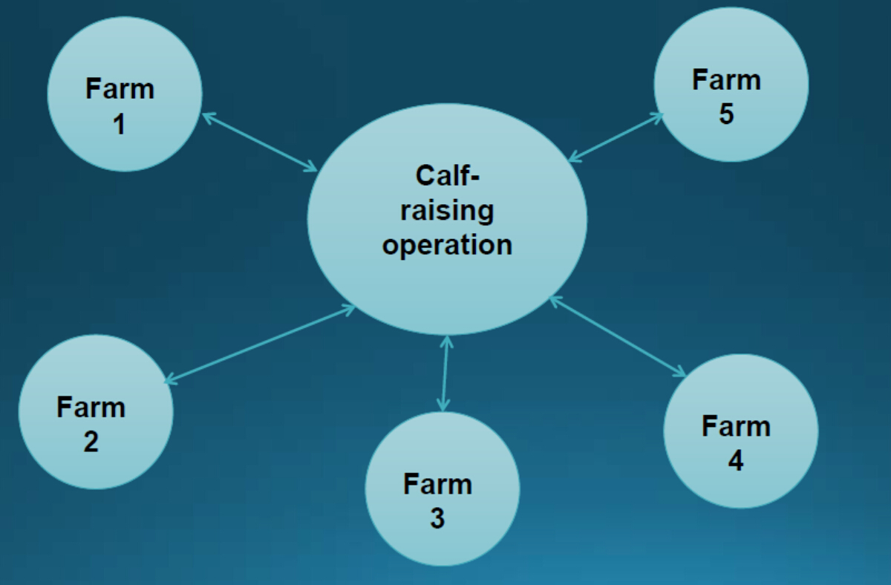
A Real-world Example: Calf-Raising Facilities

Slide 8
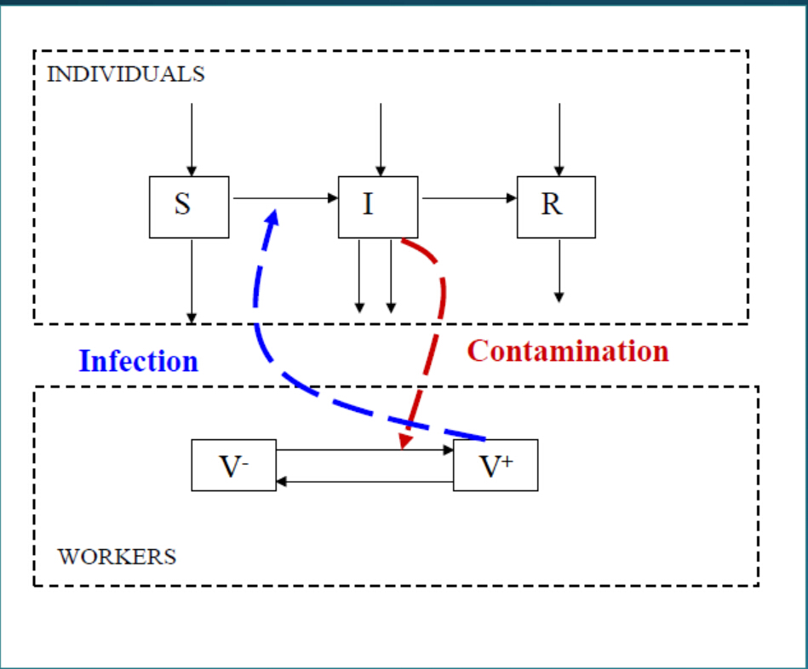
Potential Model Structure
Lanzas et al. 2008

Slide 9
The Mathematical Model
dS/dt=
dI/dt=
dR/dt=
dV+/dt=
dV-/dt=

Slide 10
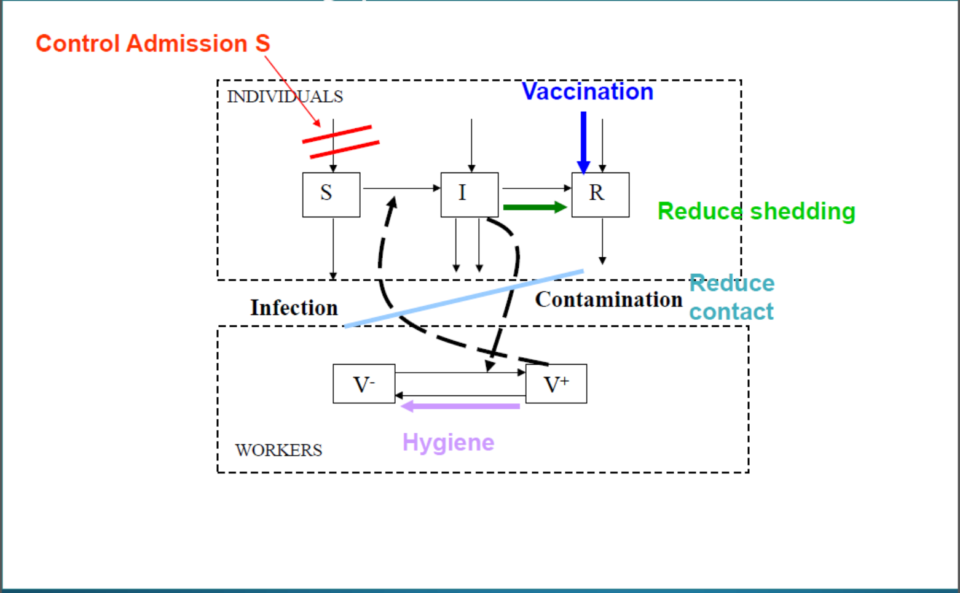
Potential Controlling in the System

Slide 11
The (New) Mathematical Model
dS/dt=
dI/dt=
dR/dt=
dV+/dt=
dV-/dt=

Slide 12
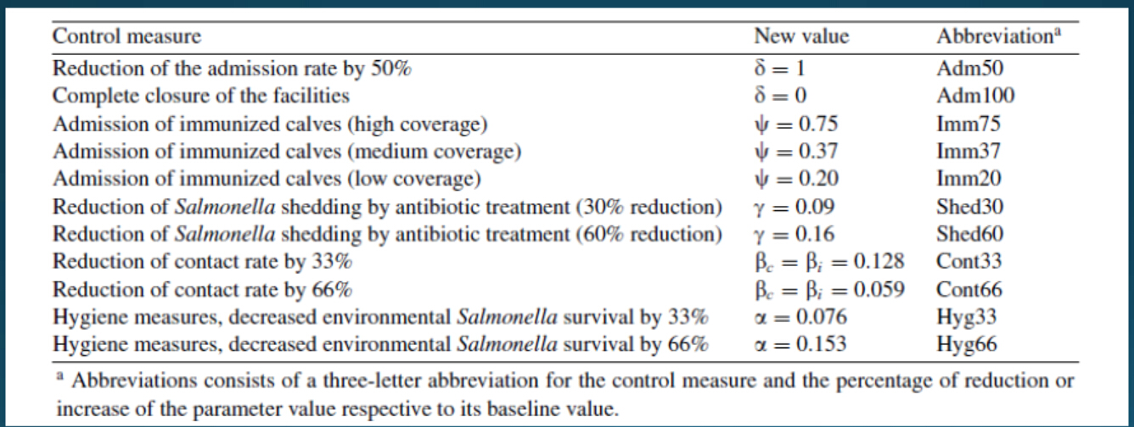
Finding the Best Controlling Strategy
Lanzas et al. 2008

Slide 13
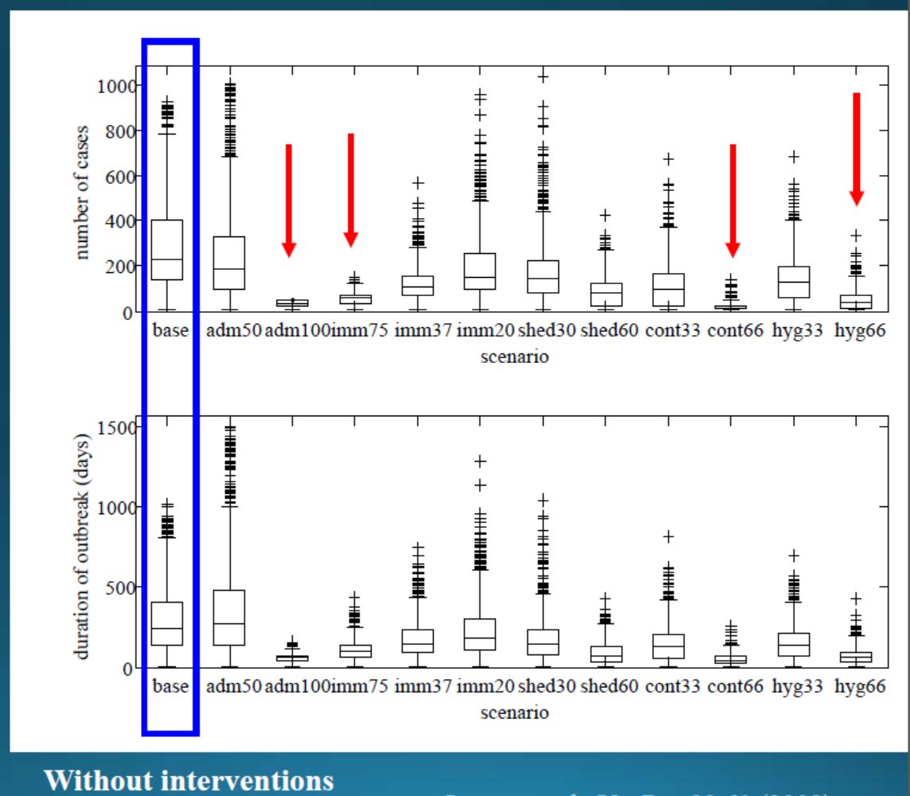
Finding the Best Controlling Strategy

Slide 14
Interpretation of the Results
1. What is the most effective strategy?
2. How sensitive are the parameters?
3. Any other factors to consider?

